Slide 1
Required soft installation

Slide 2
agenda
JDK Installation
Eclipse installation
Git installation
Cloning remote repository

Slide 3
JDK Installation
Required links:
http://www.oracle.com/technetwork/java/javase/downloads/jdk8-downloads-2133151.html
What to do?
Download Java SE Development Kit 8u161 for tour current OS (WinX64)
Don’t forget to “Accept license agreement”

Slide 4
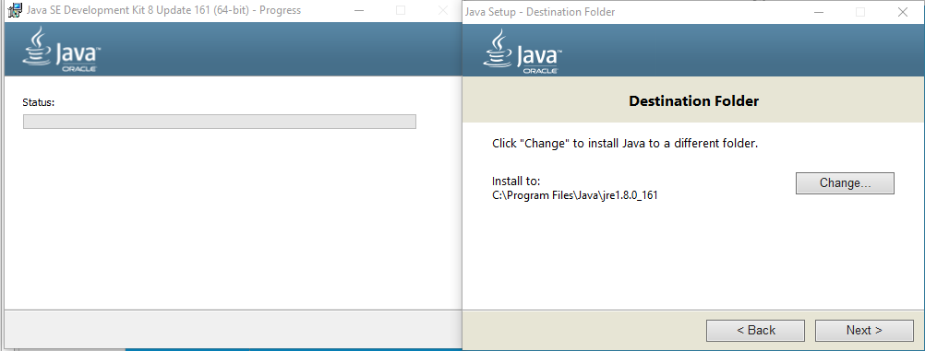
JDK Installation
Now install JDK
Run your downloaded .exe file
Follow “Next” button until it brings You to following:
When the new window appears, keep following “Next” button!
Wait until the installation completes…
GOOD JOB!

Slide 5
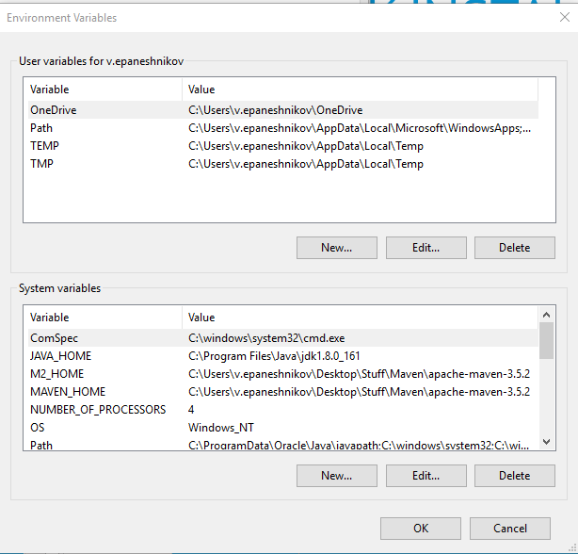
JDK Installation
Now, let’s define Java Path variable!
P.S. Path variable helps other application recognize and use our defined software, otherwise, Eclipse cannot see our Java.
What we need to do?
Win+S -> PC -> Right-Click -> Properties -> Advanced System Settings -> tab “Advanced” -> Environment Variables.
Following window should appear:

Slide 6
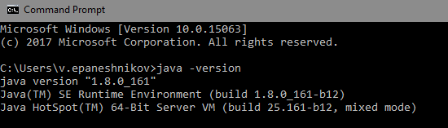
JDK Installation
Cool! Keep going:
In System variables find Path and double-click
Check if “C:\ProgramData\Oracle\Java\javapath “ exists
If not – create one, and click OK.
Let’s check:
Win+R -> cmd -> Enter
Write java -version
If All’s OK, following appears:

Slide 7
Eclipse Installation
http://www.eclipse.org/downloads/eclipse-packages/
Download Eclipse IDE For JAVA Developers x64
Extract .zip file
Go to eclipse folder (from extracted file)
Create shortcut for eclipse.exe, will be much more comfortable ☺
RUN Eclipse!

Slide 8
Eclipse Installation
First time launching Eclipse, You have to select Workspace – the place, where all your developing stuff will be stored, e.g. projects. Check “Use this workspace by default” box to pervert this window appearing again.
After eclipse loaded You can create your own project or clone it from remote repository. All the project will be in your workspace and could be accessed via other IDEs, such as IntellijIDEA, NetBeans.

Slide 9
Git installation
Link: https://git-scm.com/download/win
If You have no git account - Sing-Up!
Check with git --version

Slide 10
Cloning repository
Open command Line and go to Your current eclipse working directory
Set git user name with git config --global user.name “your_user_name_here”
Use git clone <repository link>
Check it out via Eclipse!

Slide 11
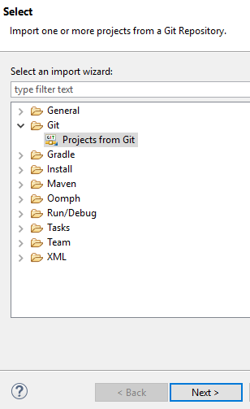
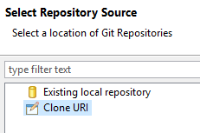
Cloning repo via eclipse
You can also clone repository using eclipse UI.
Go to “File “-> “Import”
Select “Git” -> “Projects from git” -> “Next” -> “Select Clone URI” -> “Next”

Slide 12
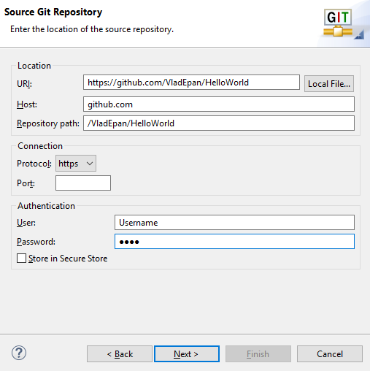
Cloning repo via eclipse
Type URI of cloning repository
Host and Repository Path should filled in automatically
Enter Your User and Password from Git account
Click Next

Slide 13
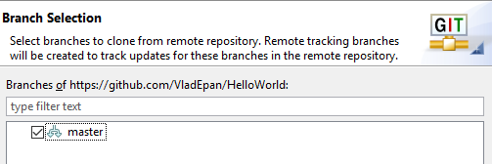
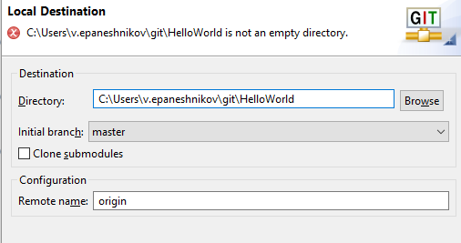
Cloning repo via eclipse
Select master branch ->
-> click Next Choose your local path for your directory -> Finish!

Slide 14
Lesson log
For a now we have:
Installed java
Working IDE
Remote project
Soon we will create the working Application, but now - Networking!

Slide 15
END

